Slide 1



SNJB
Late sau kantabai bhavarlalji jain collage of engineering, chandwad
( Department of MBA )
A Presentation Related To IOCL Ltd.

Slide 2
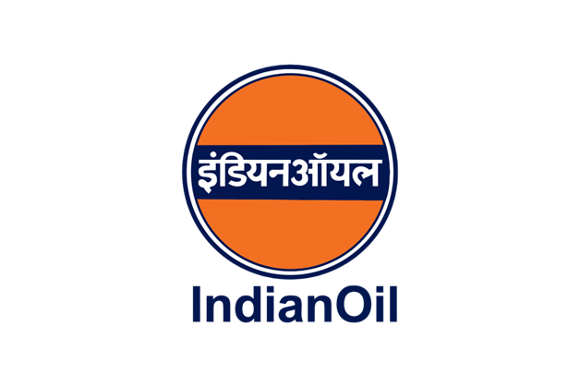
Subject Name:- (114)Enterprise Analysis & Desk Research
A Presentation Related To IOCL Ltd.
PRESENTED BY :
Shubham Pawar
Jayashree More
Shruti Sonwane
Monica Patil
Dheeraj Solunke
Guided By :- PROF. M. S. BARKALE SIR

Slide 3
Contents:-
Customers of I.O.C.L.
Products
Pipelines
Brands
Market share
Advertising Agency of I.O.C.L.
Logo & Tagline
Technological developments
Labour unrest

Slide 4
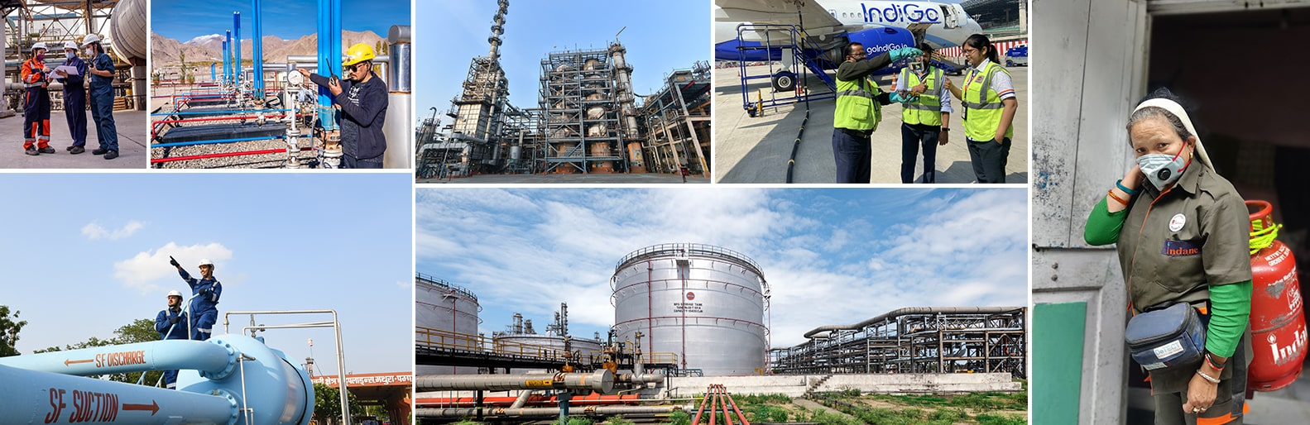
Customers of I.O.C.L.
Many customers like the Railways, State Transport Undertakings, Steel Plants, Thermal Power Plants, Textile Mills and Power Plants continue to benefit from long-term contracts signed with IndianOil for fuels & lubricants supplies and consultancy.

Slide 5
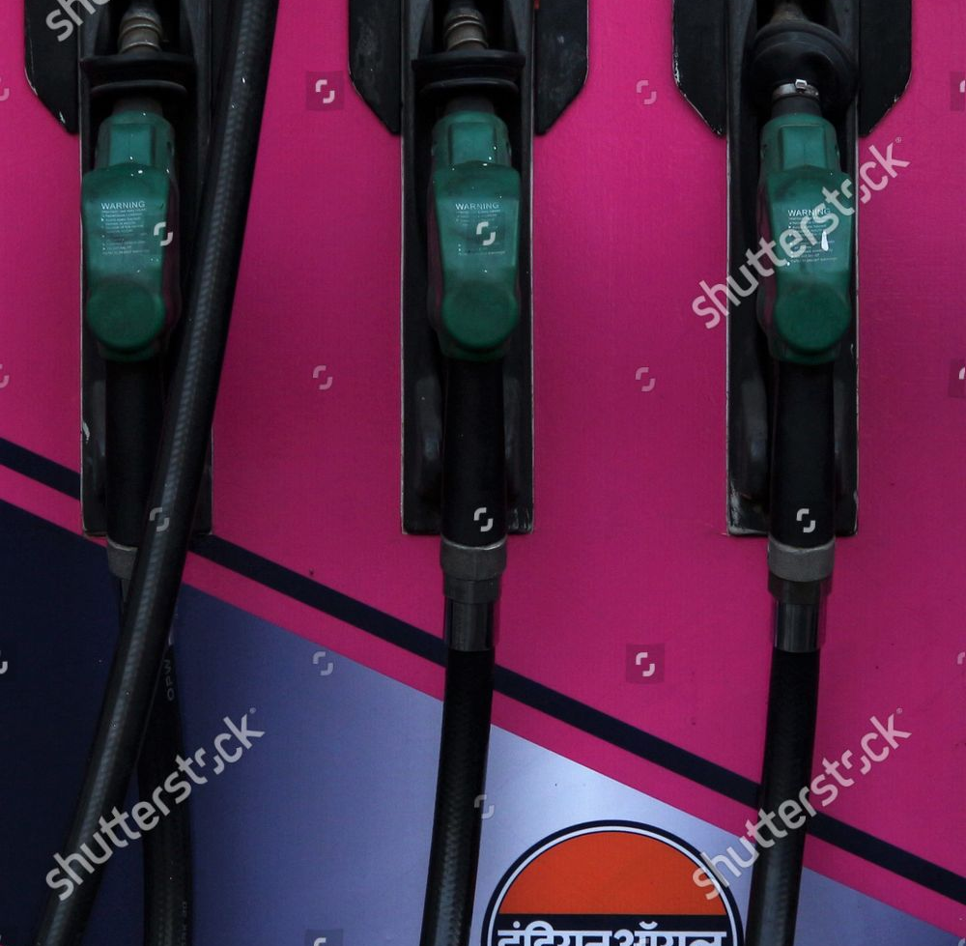
Products of I.O.C.L
There are various products serve by I.O.C.L. to our society. There are few products which I.O.C.L.
Provides in everywhere :
Products Petroleum or Heavier
PETROL
DIESEL
TURBINE
AUTO L.P.G.
Middle Distillates
Furnace oil
Bitumen
Light Distillates

Slide 6
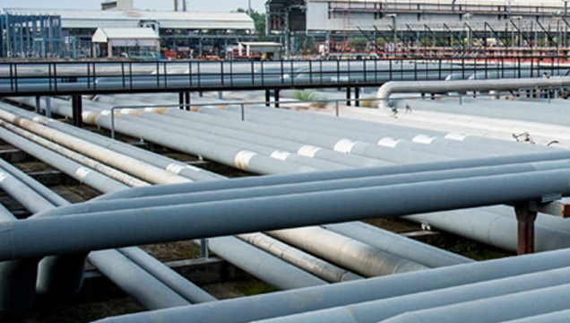
Pipelines
IndianOil operates a network of more than 15,000 km long crude oil, petroleum product and gas pipelines with a throughput capacity of 94.56 million metric tonnes per annum of oil and 21.69 million metric standard cubic meters per day of gas. Cross-country pipelines are globally recognized as the safest, cost-effective, energy-efficient and environment-friendly mode for transportation of crude oil and petroleum products.

Slide 7
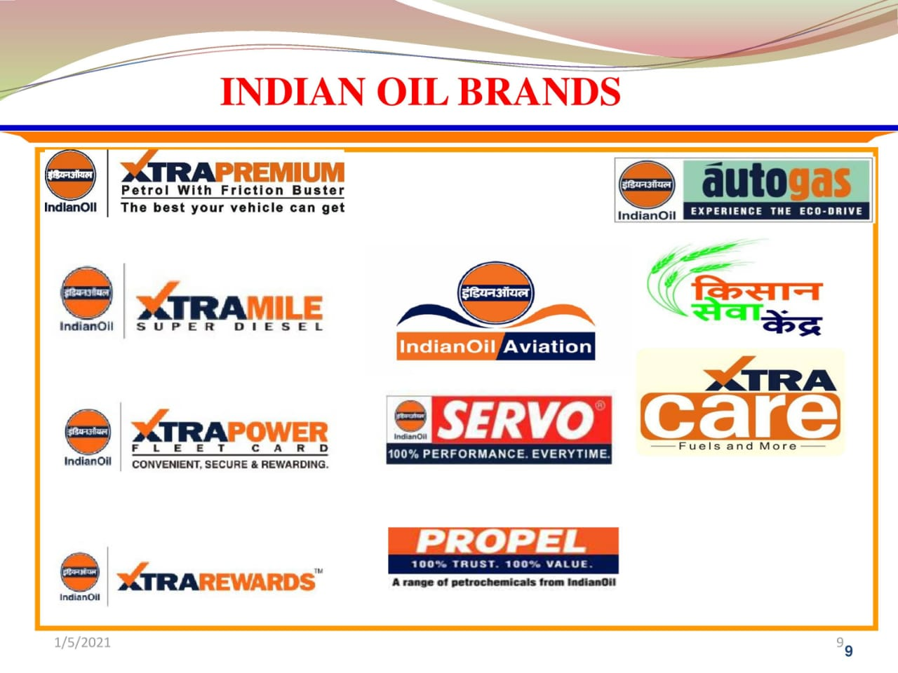

Slide 8
Advertising Agency of I.O.C.L.
Indian Oil Corporation (IOCL) has empanelled Inter Publicity, RK Swamy BBDO, Concept Communications, and Inter Ads. The business will be handled from the agencies' Delhi offices. The size of the business is estimated to be in the range of Rs 20-25 crore. The empanelment will be for a period of two years, with a provision of extension for another two years at the sole discretion of Indian Oil.

Slide 9
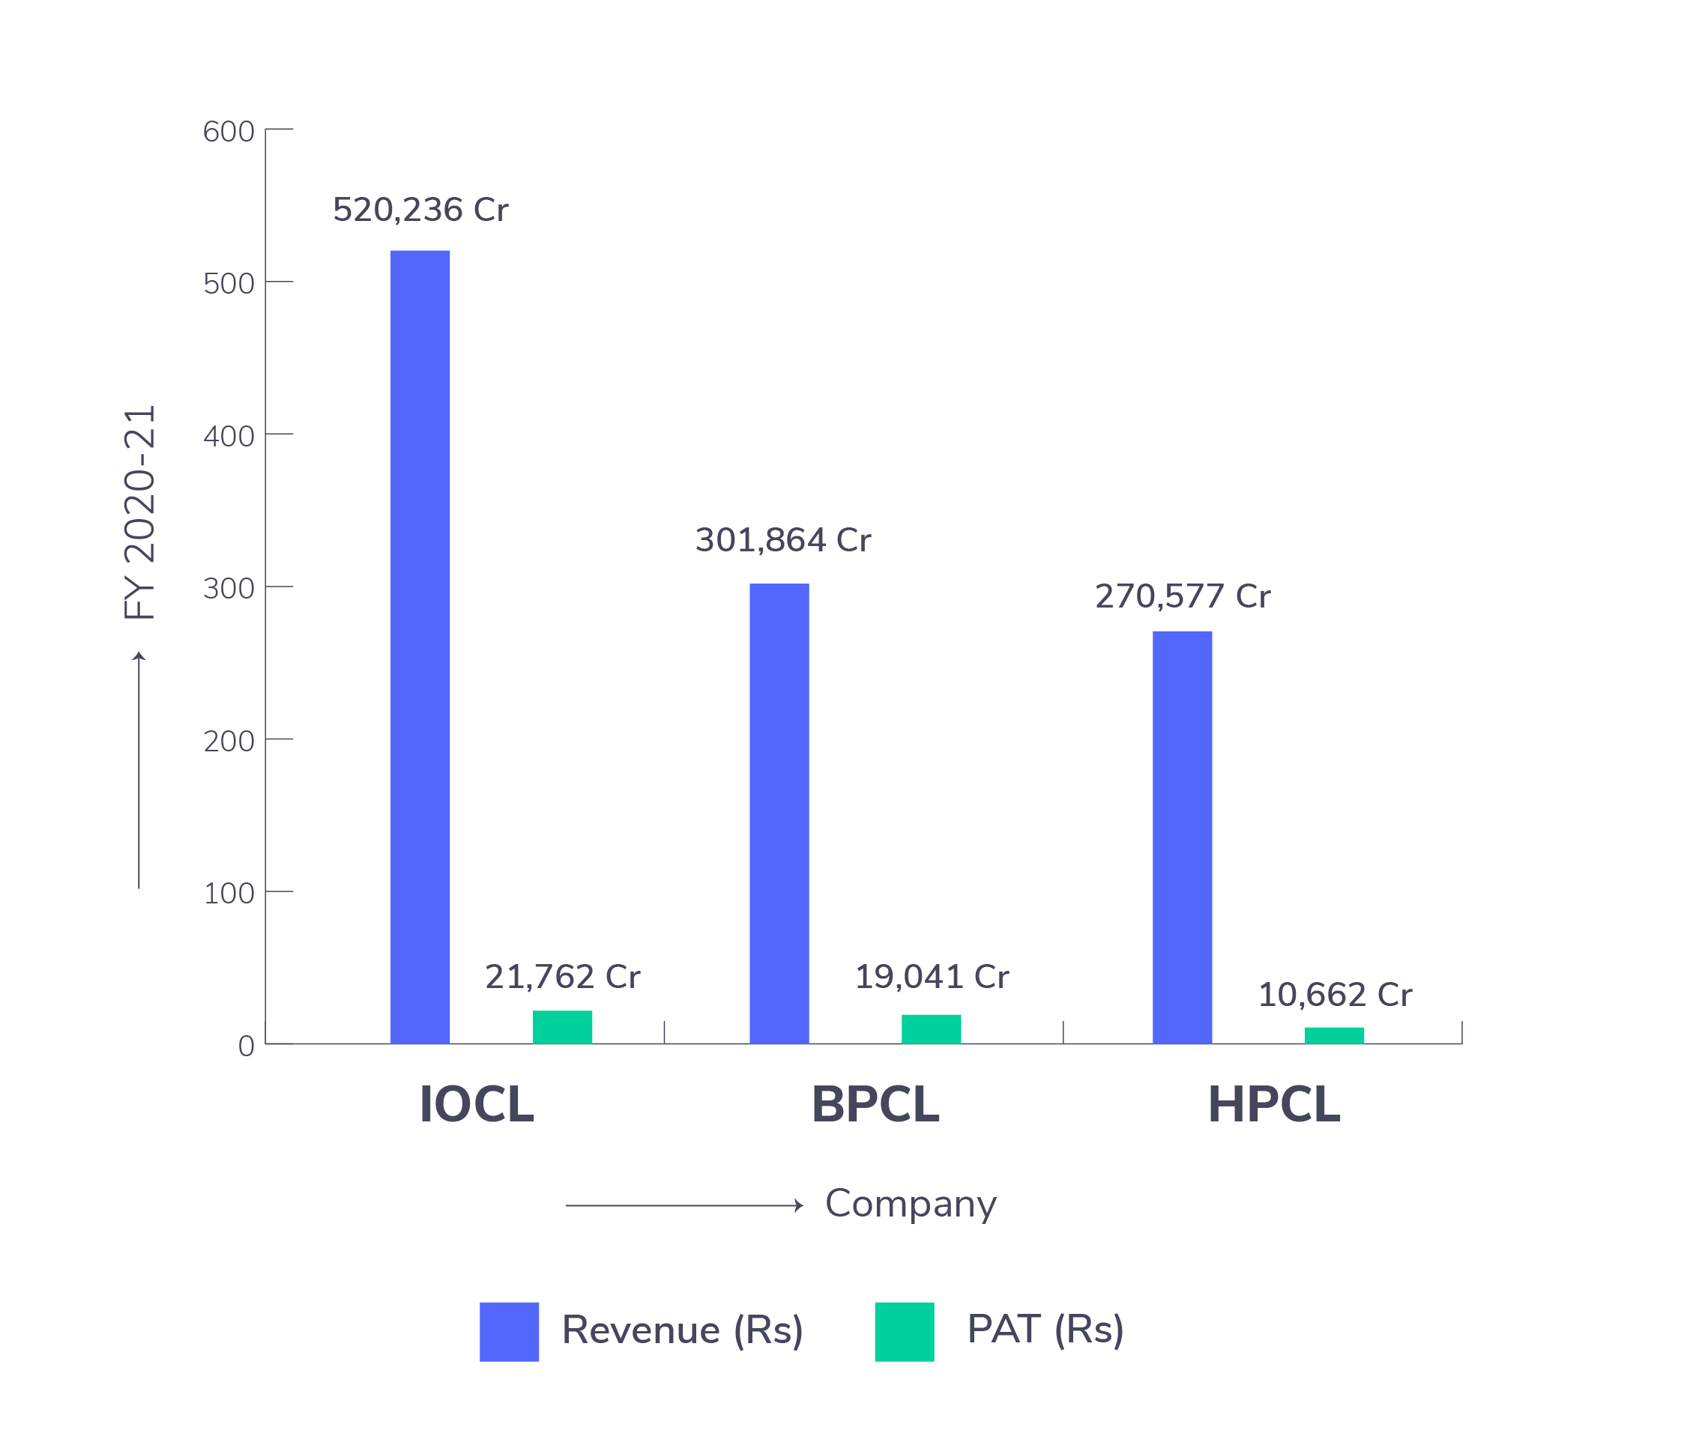
Market share of Indian oil
The oil and gas industry has an average profit margin of 4.7%. This means that about 4.7% of the money the industry brings in is considered profit and doesn't go toward paying for the company's costs.

Slide 10
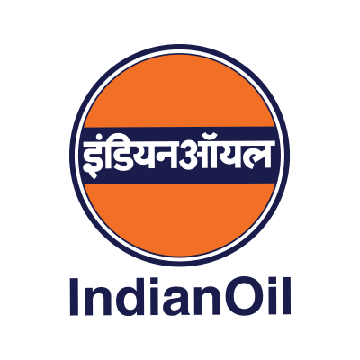
Indian Oil Corporation Logo and Tagline
Tagline
“The Energy of India
Indian Inspired
Bringing Energy to Life”
Logo of Indian Oil Corporation
This is the registered logo of Indian Oil. However, whenever the logo is not accompanied by the full name "Indian Oil Corporation Limited", the lettering "Indian Oil" in dark blue colour may be incorporated under the logo. The word "Indian Oil" should be used as one word with the letter "I" and "O" in capitals as shown. It should be in a single colour (Dark Blue) and not in two colours.
Logo of Indian oil

Slide 11
Technological deveopments of I.O.C.L
Indian Oil has a basket of technologies in the areas of lubricants and grease formulations, fuels, refining processes, biotechnology, additives, pipeline transportation, engine evaluation, tribiological & emission studies, and applied metallurgy. being the market leader in the oil & gas sector in the country.

Slide 12
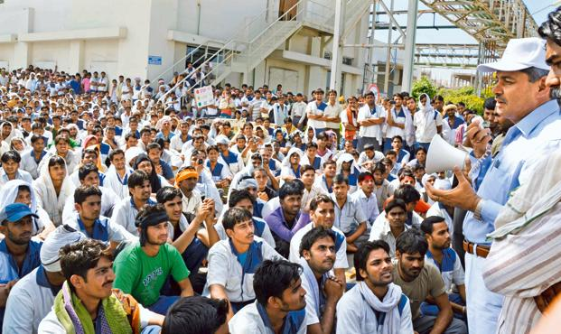
Labour unrest at I.O.C.L.
The agitators then protested against the construction work of the project being carried out by a contract agency. Subsequently, labourers working under the agency protested the agitation by the oustees leading to clash between the two groups that left 12 persons from both the groups injured. Office of the contract agency was also ransacked and vehicles at the spot damaged.
🔵

Slide 13
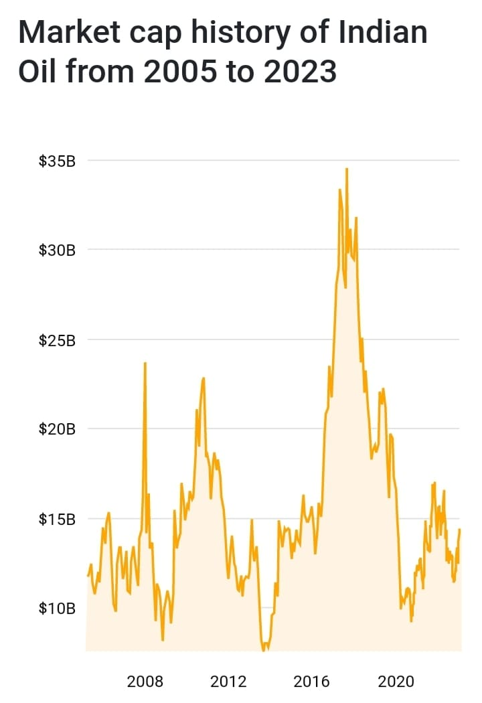
Market capitalization of Indian Oil (IOC.NS)
Market cap: $14.40 Billion
As of January 2023 Indian Oil has a market cap of $14.40 Billion. This makes Indian Oil the world's 1131th most valuable company by market cap according to our data. The market capitalization, commonly called market cap, is the total market value of a publicly traded company's outstanding shares and is commonly used to measure how much a company is worth.

Slide 14
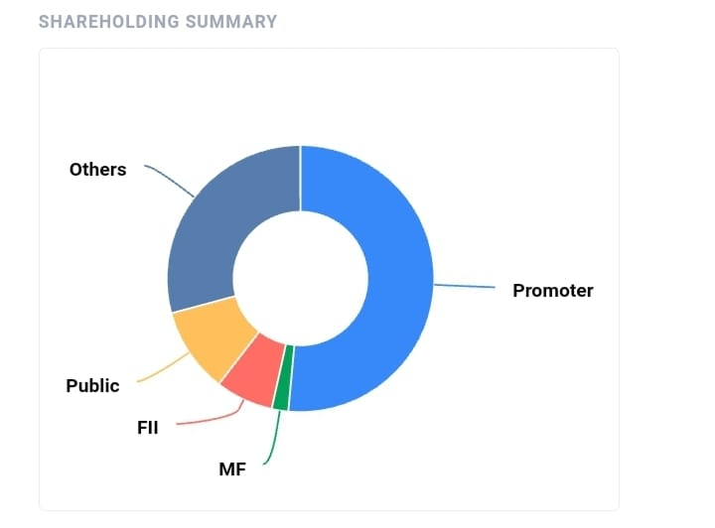
Latest Shareholding pattern and details for Indian Oil Corporation Ltd.
See FII, DII, MF, Institutional, Promoter and individuals shareholding changes, pledges, historical increases and decreases of shareholding for Indian Oil Corporation Ltd. for latest quarter in a single page.

Slide 15
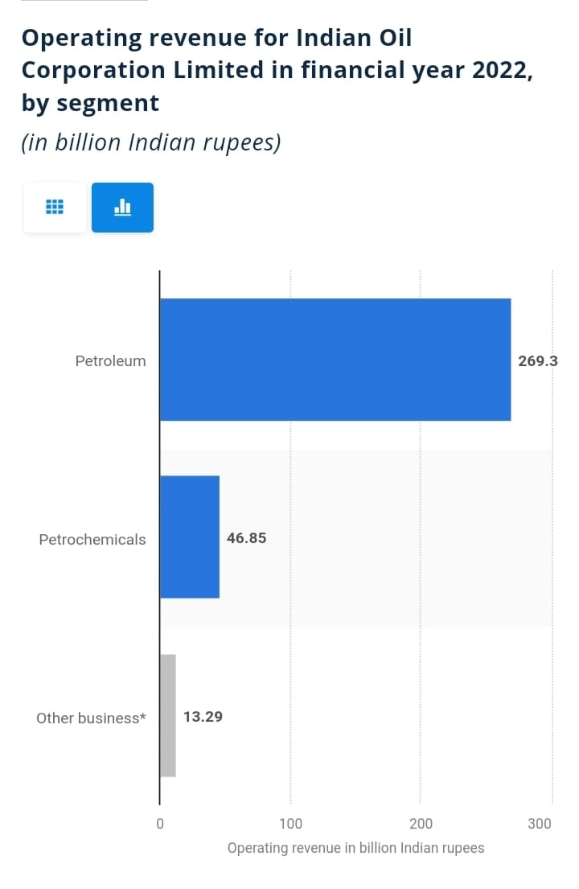
Segmented Revenues
During the financial year 2022, the petroleum segment, with over 269 billion Indian rupees was the leading revenue generator for Indian Oil Corporation Limited. In comparison, the petrochemical segment reported over 46 billion Indian rupees in revenue. The cumulative operating revenue generated in 2022 was around 7.3 trillion rupees.

Slide 16
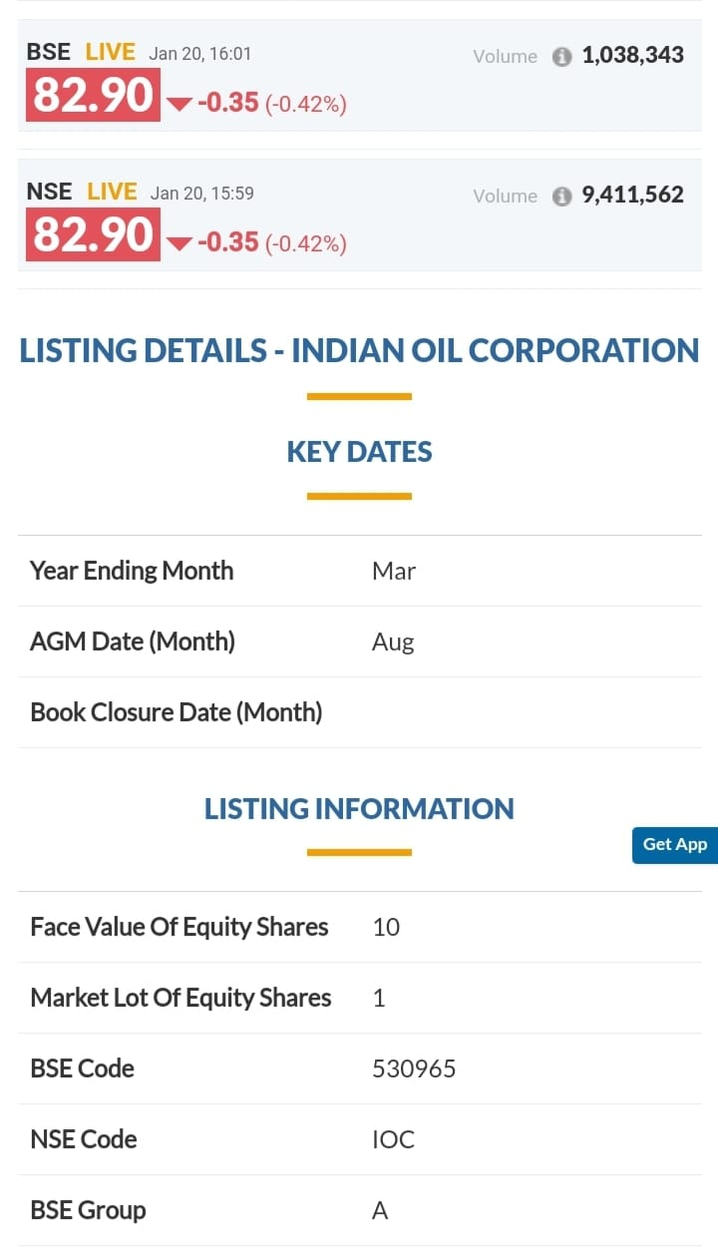

Slide 17
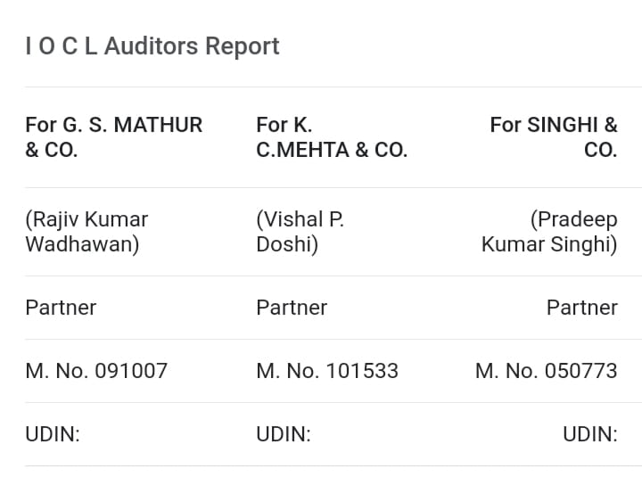

Slide 18
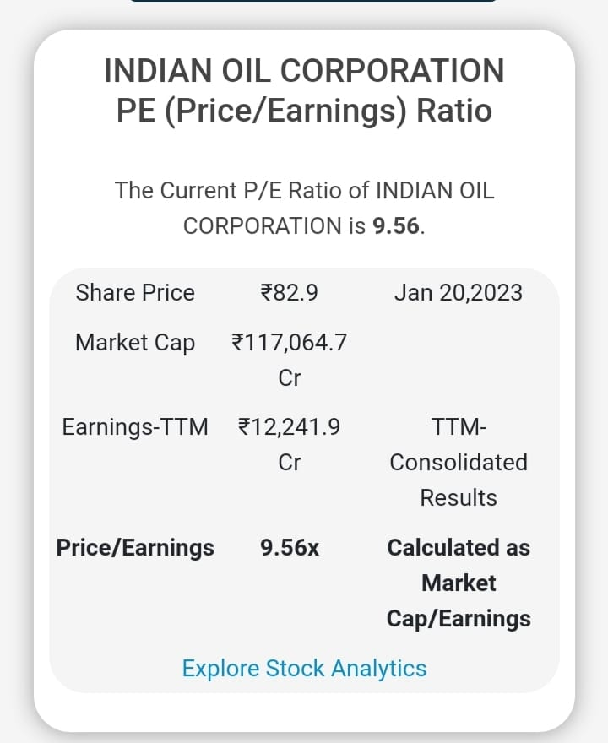

Slide 19
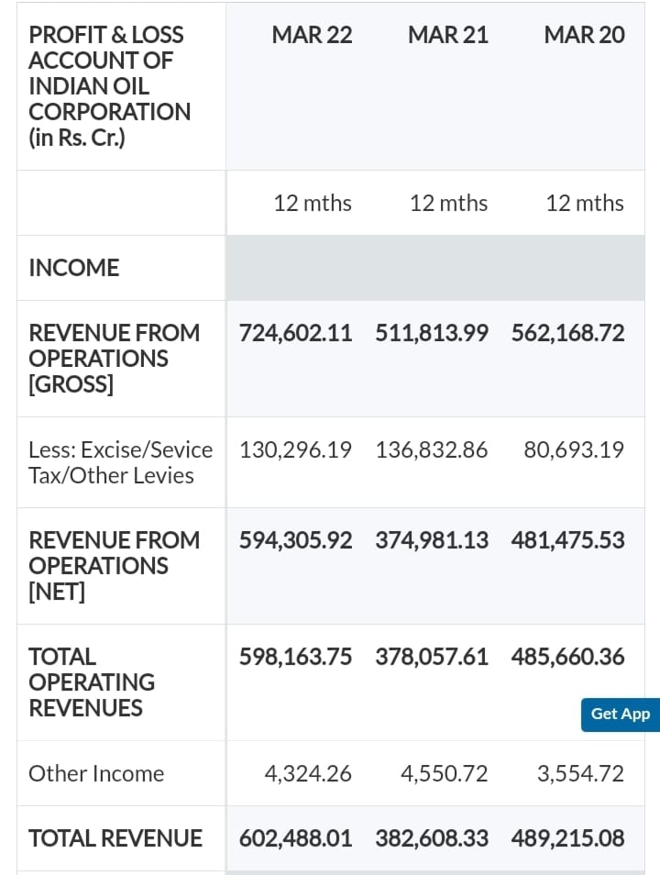

Slide 20
Content
1. Philosophy
2. Involvement in scams
3. Insider trading issues
4. CRISIL Rating
5. Major Awards and achievements of the organization in last 5 year
6. Forward looking statement of the top management

Slide 21
Philosophy
IOCL, also commonly referred as Indian oil corporation limited or Indian oil ,is an Indian state-owned oil and gas corporation with its headquarter in new Delhi. It is the largest public corporation in Indian in terms of revenue. It is the world’s 88th largest corporation in the fortune 500 list and one of the seven public sector undertaking ‘(PSU)which are conferred on with the “maharatna “ status by the government of India .The government of India currently holds 79%stake in the company and is rated the Asia . Pacific region’s number 1”petroleum trading company .

Slide 22
CRISIL Rating
CRISIL Rating has assigned its ‘CRISIL AAA/Stable’ rating to Rs 2500crore non-convertible debentures (NCDs) of Indian oil corporation limited (IOCL) and has reaffirmed its ‘CRISIL AAA/stable/CRISIL A1+ ratings on the bank facilities and other NCDs.
The rating continue to reflect the dominant position of IOCL in the oil refining and marketing sector and its strong operating efficiency. In fiscal2022, revenue grew by 65%on a year-on –year basis to Rs 602,179crore, led by pickup in demand and a low base effect.

Slide 23

Insider trading issues
NOTICE FOR CLOSURE OF TRADING WINDOW UNDER INSIDER TRADING CODE
It is hereby notified that in terms of Clause 9.1 of the “Code for prevention of Insider Trading in
the securities of Indian Oil” (Insider Trading Code), the “Trading Window” for dealing in
securities of Indian Oil shall remain closed from Tuesday, 1st October 2019 to Saturday, 2nd
November 2019 for "Insiders".
During the window closure period, the “Insiders” of IndianOil shall not deal in any transaction
involving purchase or sale of IndianOil “Securities” either in their own name or in the name of
their “immediate relative”.

Slide 24
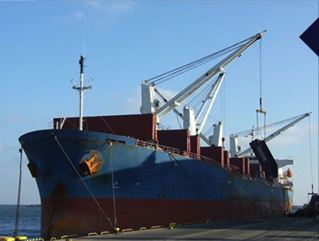
Involvement in scams
LANKA IOC PLC
Indian Oil's entry into Sri Lanka is in line with its Vision of becoming a transnational energy major. While expanding its market base to convert the surplus avails of petroleum products into more wealth for stakeholders, Indian Oil is also committed to being a good strategic partner to Sri Lanka. Its vast experience in downstream petroleum operations in India is helping create a healthy and competitive petroleum industry in Sri Lanka.
Bunkering by Lanka IOC
Lanka IOC is the only physical supplier engaging independent surveyors and bunker supervisors for all bunker supplies.

Slide 25
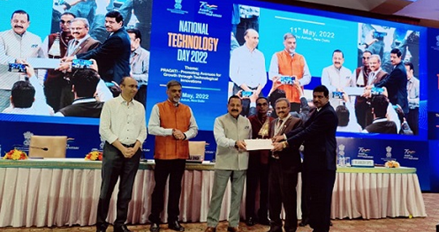
Major Awards and achievement of the organization
Date:11/05/2022
Indian Oil's Octamax technology wins country’s top technology award
History was made yet again when Octamax technology developed by Indian Oil R&D swept the country’s top technology award. The much-coveted award was presented by Dr. Jitendra Singh, Hon’ble Minister of State for Science and Technology (I/C), to Indian Oil R&D team led by Dr. SSV Ramakumar, Director (R&D).

Slide 26
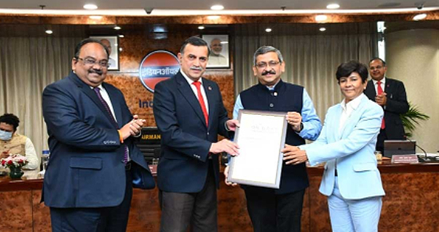
Date:16/03/2022
Indian Oil bags the prestigious Asian Oil and Gas Award for Covid Management and New Product of the Year
Adding another feather to its cap, Indian Oil bagged the prestigious Asian Power's Asian Oil & Gas Awards in two major categories of 'Covid Management Initiative of the Year' and 'New Product of the Year' in India.

Slide 27
Forward looking statement of the top management
The Company’s nationwide presence as the leading player
in petroleum product markets across the downstream
value chain is its key advantage. It positions itself for a
future where India will be leading the global oil demand
growth. The Company draws its strength from its carefully
planned infrastructure build-up over the past 60 years, its
thrust on operational excellence, its motivated workforce
of more than 31,000 employees, along with lakhs of
channel partners and contract workers working on its
projects and ensuring the last mile delivery with a smile.
“The Company draws
it strength from its
carefully planned
infrastructure built-up
over the past 60 years”

Slide 28

Forward looking statement
Forward-looking Statements
We have exercised utmost care in the preparation of this report. It might include forecasts and/ or information relating to forecasts. Facts, expectations, and past data are typically the basis of forecasts. As with all forward looking statements, the actual result may deviate from the forecast. As a result, we can provide no assurance on the correctness, completeness, and up-to-date nature of the information for our forward-looking statements, as well as for those declared as taken from third parties. Reader discretion is advised. We undertake no obligation to publicly update any forward-looking statements, whether as a result of new information, future events, or otherwise

Slide 29
Shubham Pawar
Jayashree More
Shruti Sonwane
Monica Patil
Dheeraj Solunke

